Slide 1


HR Analytics Predicting Employee Promotions
IST 707 Applied Machine Learning

Slide 2
Background

Slide 3
Problem Statement
A multinational corporation has collected data about its employees including:
promotions, education, gender, training, previous year rating, service length, training
score, and other HR-related features
Employees in this corporation are promoted only after a thorough evaluation cycle and this leads to a delay in transitions to new roles.
The corporation has 9 broad verticals and they would like to:
identify the right employees for promotion
prepare employees for their new role ahead of time

Slide 4
Business Questions
Is it possible to pre-determine employees who will be promoted?​
Is it possible to create a model that HR could use to identify great candidates to be promoted?​​
What are the critical drivers of promotion? Gender, region, department, training, service time, education, etc.?

Slide 5
Exploratory Data Analysis

Slide 6
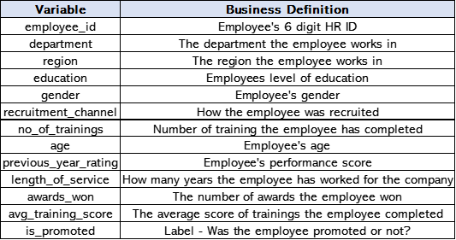
About the Dataset
Dataset for modeling and analysis: contains 12 descriptive variables and a label (promoted or not promoted) for 54,000 employees.
Dataset for prediction: contains 12 variables for 23,500 employees.

Slide 7
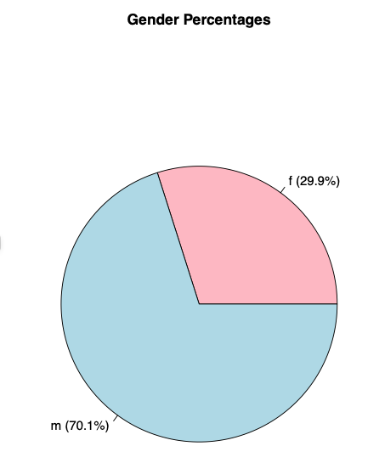
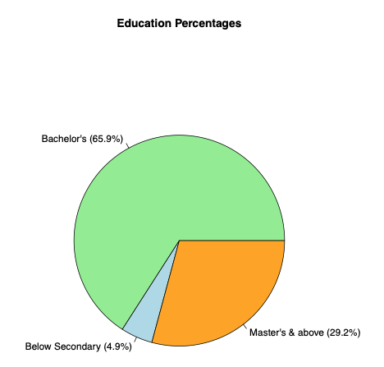
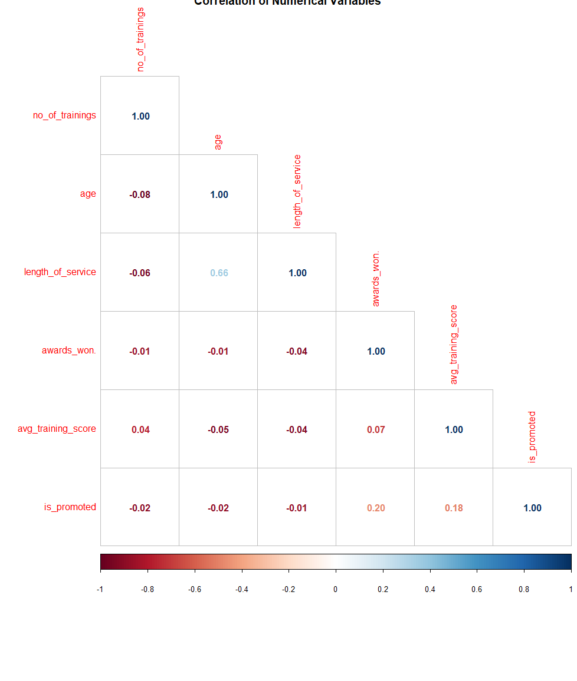
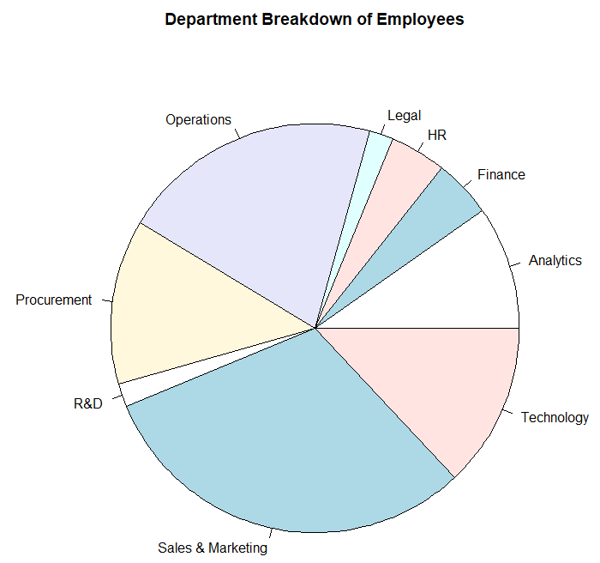
Visualizations
Notes:
For the EDA we looked each of the variables and their percentage breakdowns to understand how these affected promotions.
For example, the higher the education level of an employee, their chance of being promoted was higher.

Slide 8
Modeling

Slide 9
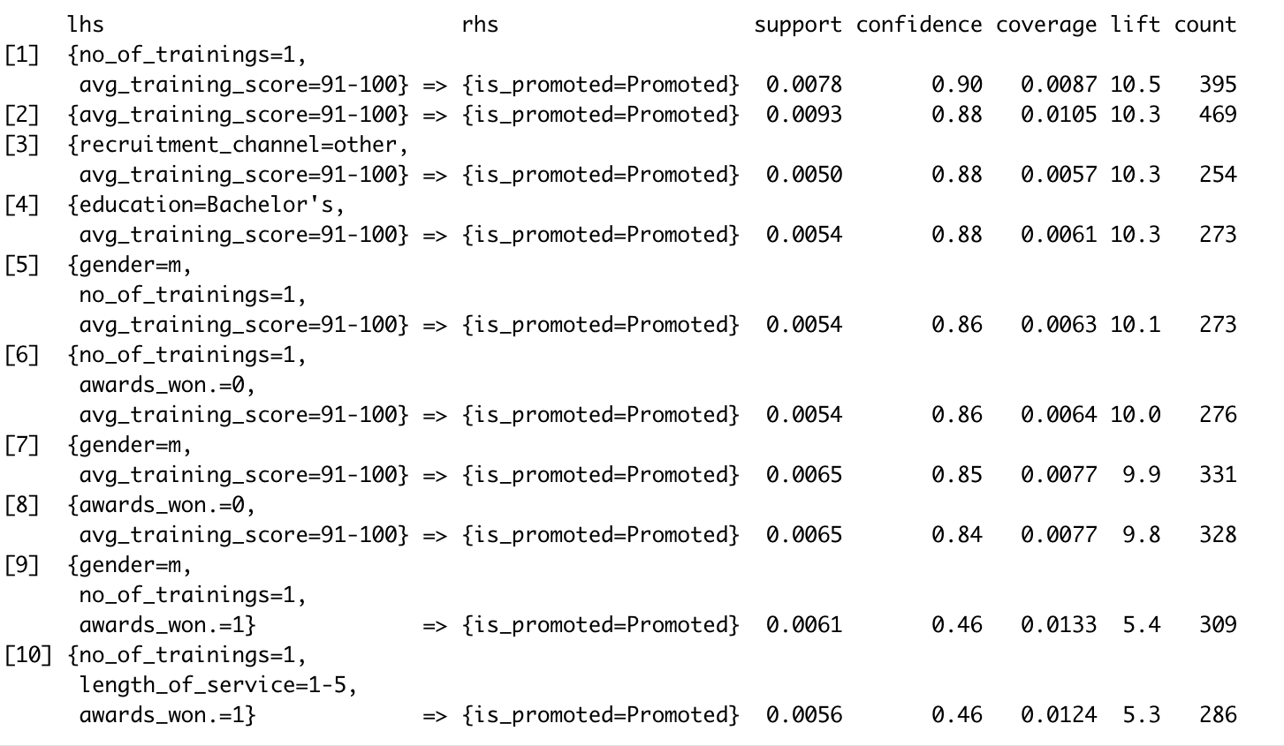
Association Rule Mining
Employees who were promoted had the highest training scores
Notes:
Our first modeling technique was Association Rule Mining. We found that we can be over 80% confident that employees who had high training scores would be promoted.

Slide 10
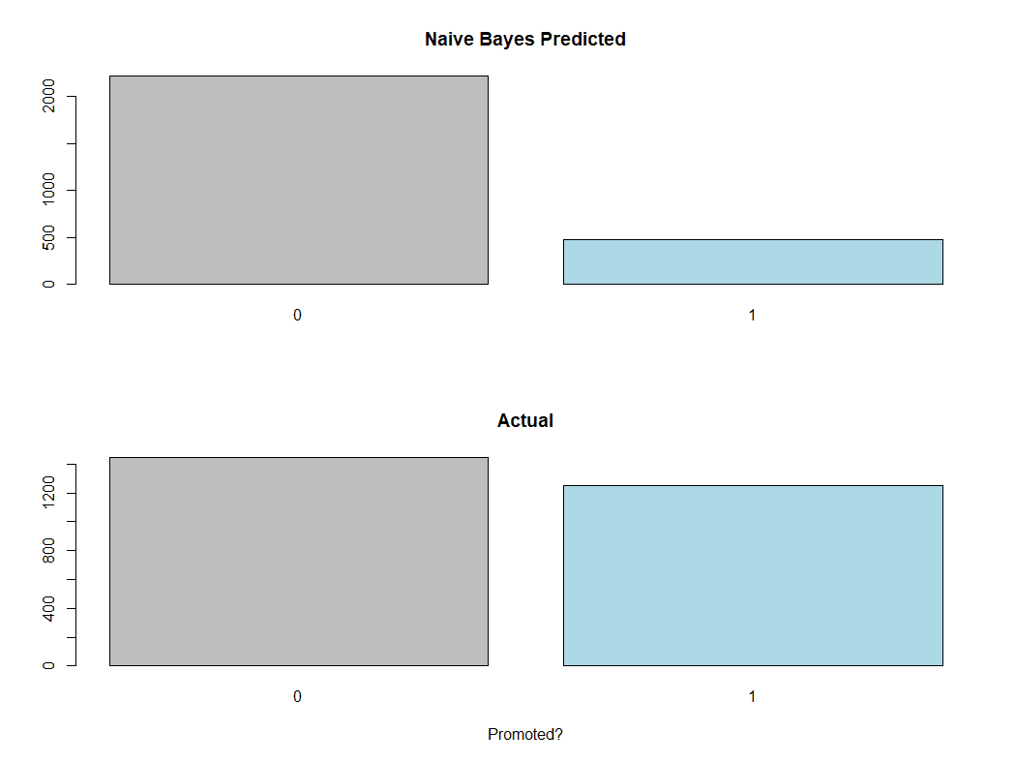
Naïve Bayes
Accuracy: 64.6%

Slide 11
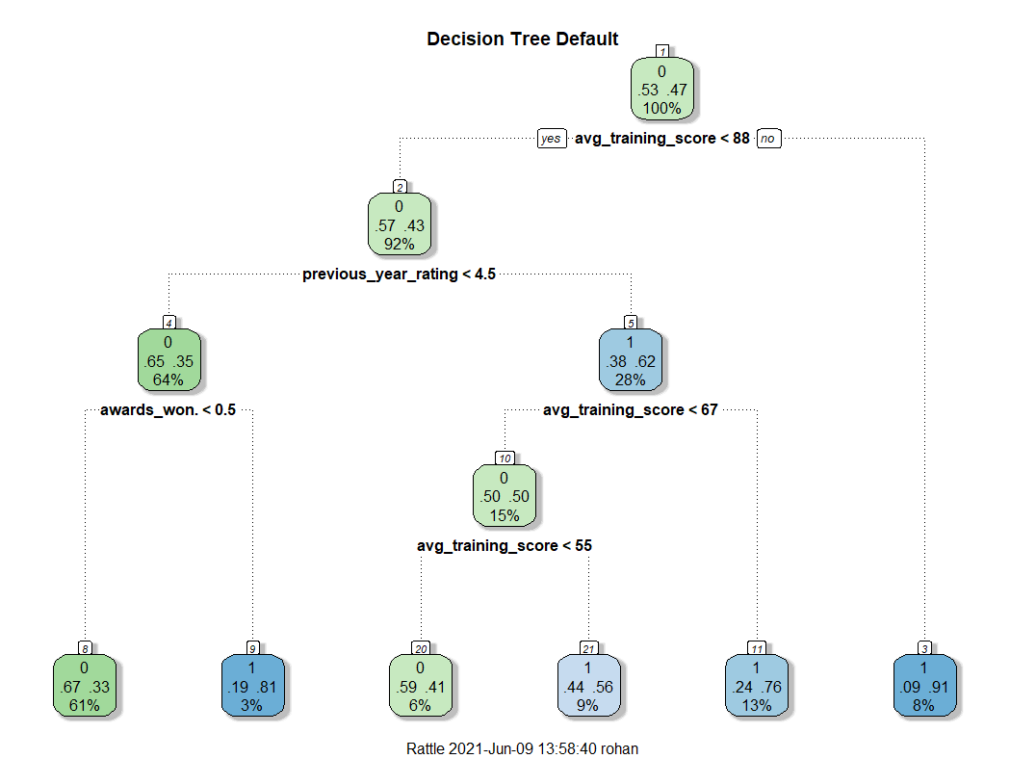
Decision Tree
Accuracy: 68.1%

Slide 12
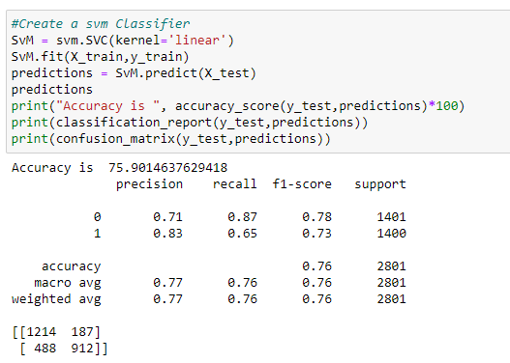
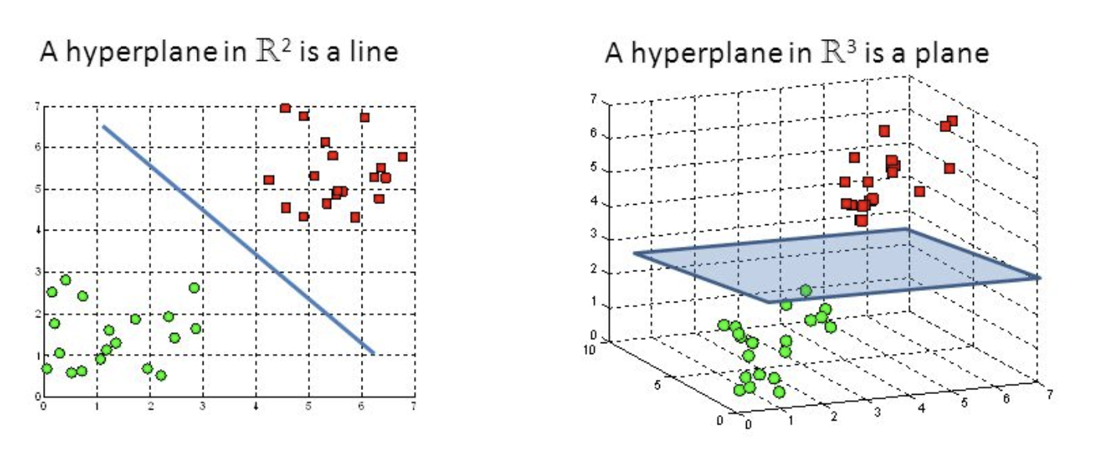
Support Vector Machine
Linear Accuracy: 75.9%
Poly Accuracy: 74.93%
Radial Basis Function Accuracy: 74.90%

Slide 13
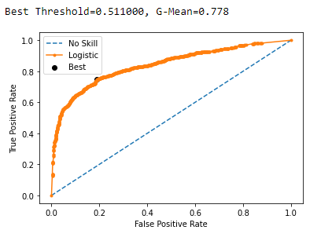
Random Forest
Accuracy: 77.8%

Slide 14
Conclusions

Slide 15
Summary
Model | Accuracy
Decision Tree | 68.10%
Naïve Bayes | 64.60%
Support Vector Machine | 74.90%
Random Forest | 77.80%
Is it possible to pre-determine employees who will be promoted?​
Yes, multiple modeling techniques prove that it is possible to predict employees that will be promoted.
Is it possible to create a model that HR could use to identify great candidates to be promoted?​​
Yes, a random forest model can be used to identify great candidates for promotion.
What are the critical drivers of promotion? Gender, region, department, training, service time, education, etc.?
Average training score, the previous year’s performance rating, and awards won are critical drivers of promotion.

Slide 16
Questions?

Slide 17
Thank you!

